Slide 1
Andrew Jackson 1829-1837

Slide 2
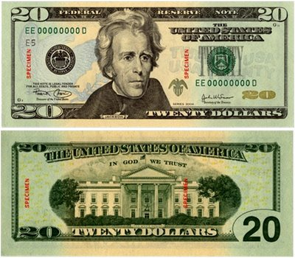

Slide 3
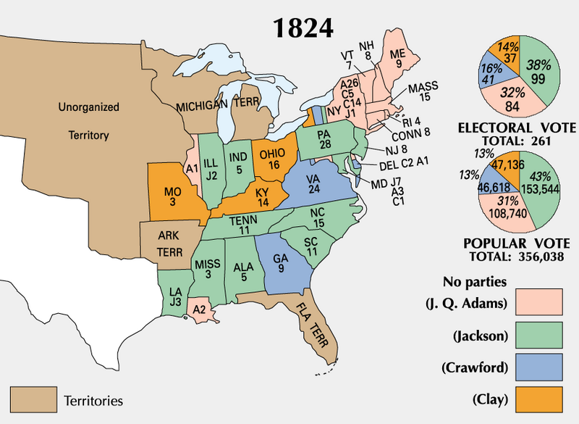

Slide 4
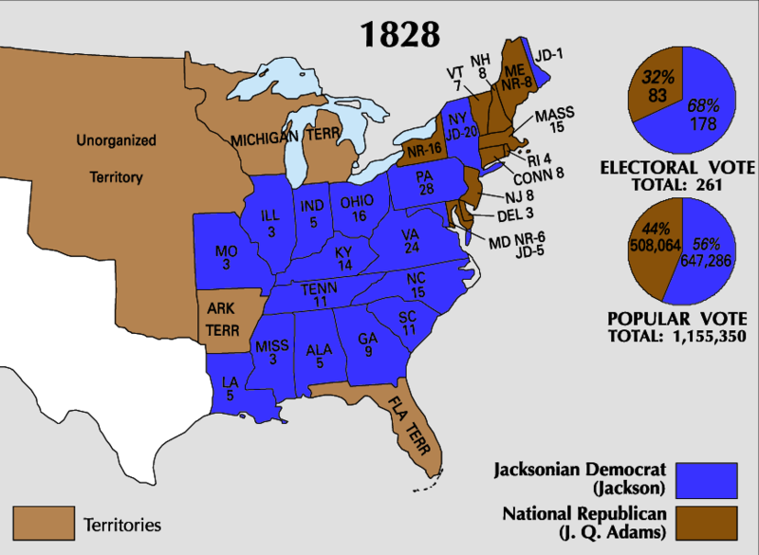

Slide 5
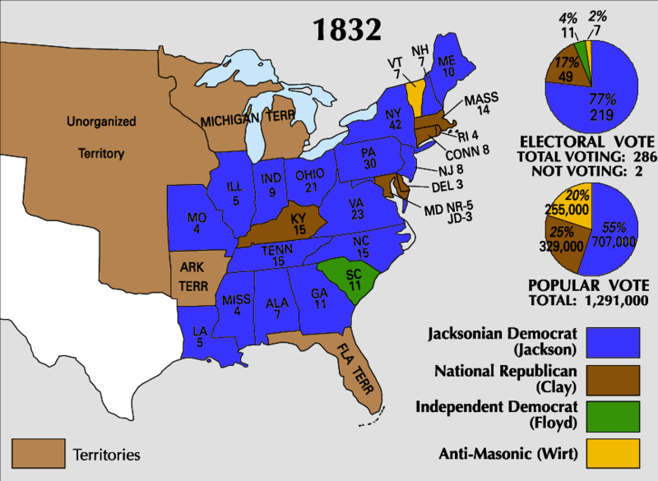

Slide 6
Jackson’s Appeal
Military Hero-Battle of New Orleans
Seen as common man-Began life poor
Slave owner-popular in south
From the west-Tennessee

Slide 7
Jackson’s “Firsts”
Born into poverty
Immigrant parents-only one until Obama
First from west-Tennessee
First president not from Mass. or Virginia
Appeal as helping the common man led to
Spirit of reform-make US better

Slide 8
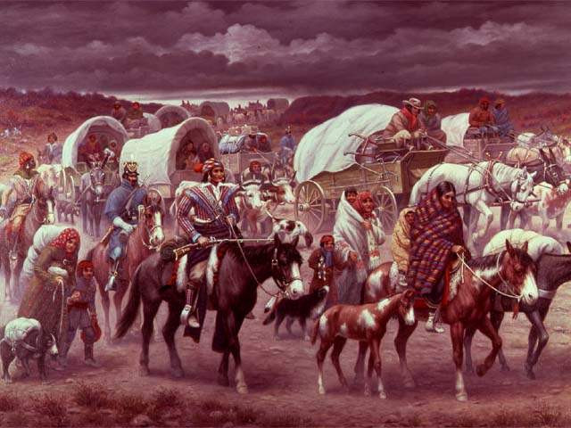

Slide 9
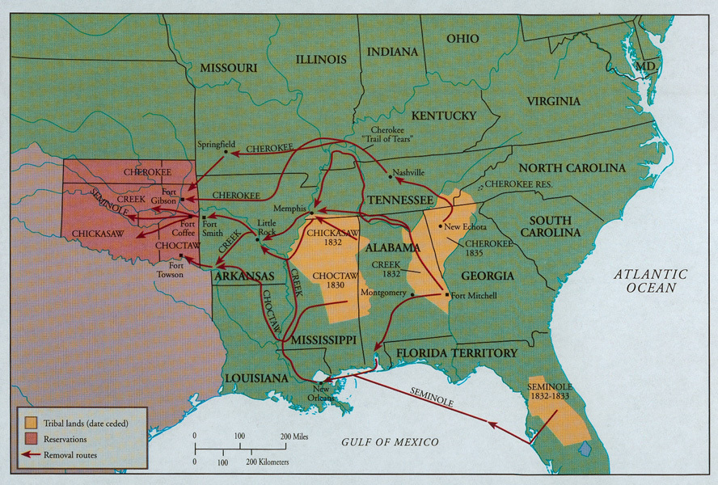

Slide 10
